Slide 1

Get good at AI.
Properly.
THE GOOD AI GUIDE
Why most people stall after a few quick wins, the one idea that gets them unstuck, and a free path from curious to capable.
Fabian Mösli
CPO & Chief AI Officer · goodaiguide.com
About 20 minutes · zero jargon · one small homework assignment
Notes:
Welcome. One promise before we start: no jargon, nothing to install, and you'll leave with exactly one small thing to do this week.
[Ask the room] Hands up if you've tried ChatGPT, Copilot or Gemini at least once. Now keep your hand up only if it's become part of how you work every day. [If most hands go down again, that gap is what the next 20 minutes are about.]
I'm Fabian. My day job is product and AI at a Swiss healthtech startup, where I'm CPO and Chief AI Officer. On the side, I write the Good AI Guide, a free site that helps people get properly good at AI. Everything in this talk is on that site, so there's no need to take notes.

Slide 2
Day one: magic. Week three: meh.
WHERE MOST PEOPLE ARE
Uses it daily, on real work
Most people
How useful AI feels
It wrote a poem about my cat. In four seconds!
With the right picture and some practice
Two things get people off the plateau: the right picture of what AI is, and a little deliberate practice.
The plateau of “It’s fine, I guess. Bit overhyped.”
Asked for a marketing plan. Got a horoscope.
This talk is about both.
An illustration, not data.
Notes:
This is the curve I see over and over.
[Point at the peak] The first week is genuinely magical. A poem, a summary, a decent email in seconds. Then you ask it something that matters at work, a plan or a strategy, and you get an answer that would fit any company on earth. A horoscope.
So people conclude it's overhyped, use it for the odd email, and stay there. That flat line is where most people are today, and talent has little to do with it. Two things are missing: the right picture of what you're actually talking to, and a bit of deliberate practice.
The indigo line is what happens with both. The rest of this talk is about how to get onto it.

Slide 3






Which of these is you?
SOUND FAMILIAR?
1
I tried ChatGPT and got generic answers.
2
My company blocked ChatGPT. I got Copilot.
3
I’m meant to lead on AI. Where do I start?
Guide: Getting Started with AI
Guide: Your Company Blocked ChatGPT. Now What?
Guide: Giving Everyone Copilot Isn’t an AI Strategy
4
I use AI every day and want to go further.
5
Honestly, AI makes me a bit uneasy.
6
Everyone else seems to build amazing things.
Guide: Don’t Talk to One Claude. Spawn a Team Instead.
Guide: Is It Safe? What Happens to What You Type Into AI
Guide: The Weekend Trip That Came With Its Own App
Each line opens the guide I’d hand you first. They’re the doors on the homepage.
Notes:
Six situations this site is built around.
[Ask the room] Which one is closest to you? Shout a number. [Wait for a few answers.]
Whatever you picked, you're in good company, and none of them means you're behind. Each has a guide written for exactly that situation, and the site's homepage shows these six lines as doors.
Two worth calling out. In my experience, number 2 is the most common one in larger companies: the good tools are blocked and you got Copilot or an internal chatbot. That's fine, and we'll come back to it. And number 5 is a reasonable place to start: the guide tells you what actually happens to what you type.

Slide 4




Your AI is a brilliant new hire on day one
THE ONE IDEA
What it knows
What it doesn’t
More than anyone you’ve ever met
Your customers
Python, Portuguese and project plans
Your team’s acronyms
Sonnets, formulas, polite ways to say no
Why last year’s project quietly died
Works at 3 a.m. without a sigh
That “the usual” means the Thursday report
When the answer is generic, it usually says more about the brief than about the model.
Guide: Your AI Has No Idea What Your Company Does
Notes:
If you remember one thing from today, make it this picture.
Imagine the smartest graduate you've ever hired. Top of their class, has read everything, absurdly fast. It's their first day. They've never met your customers, they don't know your product, and they have no idea why last year's project died.
Now you walk up and say: "Write me a strategy for Q3." You'd get a textbook answer, and you'd never brief a human colleague that way. But that's how most of us talk to AI.
The picture explains the other quirks too. A new hire who doesn't know the answer but wants to please will sometimes fill the gap with a confident guess. That's what people call hallucination.
So the fix is what you'd do with any new colleague: give context, explain what good looks like, and check the first drafts.

Slide 5

Same AI, same question. Different brief.
THE SAME IDEA, IN PRACTICE
How should I think about using AI for customer communication?
Without a profile
With a short profile
“Artificial intelligence can significantly transform customer communication in several ways. Consider implementing AI chatbots for handling frequently asked questions, which can reduce response times and free up your team for complex issues…”
CPO
Healthcare software
Switzerland
Hospital HR users
“Given that your users are hospital HR directors — conservative, busy, and quick to blame the software when something feels off — the move is reliability over novelty…”
Correct. Useless.
Specific. Usable.
Average input, average output. Guide: The Setup That Makes AI Stop Being Generic
Notes:
Here's that idea in practice, with a real example from one of the guides.
Same AI, same question. On the left, an account that knows nothing about me. Read it: it isn't wrong. It's addressed to an imaginary average businessperson.
On the right, the same question from an account with a short profile: my role, my industry, my country, who my users are. Now it talks about hospital HR directors and why they distrust anything that feels like a chatbot. That's advice I can act on.
Writing that profile took a few minutes, once. Most assistants let you store a profile like that, so every new chat starts from it. Where yours doesn't, paste it at the top of the chat. That alone moves a lot of people off the plateau.

Slide 6





Nobody learns to cook from cooking shows
HOW PEOPLE ACTUALLY GET GOOD
The usual plan
What works
1
Watch a four-hour tutorial on “prompt engineering”
Use it on real tasks, a little every day
2
Buy a course, never finish module three
Set yourself small challenges, and finish them
3
Read “10 AI tools that will change your life”
Learn what good looks like, so you notice when it isn’t
4
Follow 50 AI influencers
Want theory too? One good course, then back to the reps
5
Feel overwhelmed. Do nothing.
Guide: How to Actually Get Good at AI
Notes:
So how do you get from the flat line to the rising one? Not the way most of us try.
[Point left] This is the usual plan, and step five is where it usually ends. The material isn't the problem. Some courses are excellent, and if you want one, take one; there are better courses out there than anything I'd make.
But watching doesn't build the intuition you need, the same way nobody learns to cook from cooking shows. You learn by standing in the kitchen and burning a few things. With AI that means using it on real work, a little every day, with small challenges you actually finish. And it helps to know what good looks like, which is what the site's levels and checklists are for.
That's how I learned most of what I know: by using it constantly, stubbornly, and sometimes badly.

Slide 7

Half have tried it. Few use it seriously.
WHY NOW
~50%
~3%
Few
of working-age adults have tried generative AI
of AI users pay for it
have built it into their daily work as a system
St. Louis Fed, 2025 · US
Menlo Ventures, 2025
Nobody counts this one. At AI roundtables and conferences, they’re a small minority.
AI skill compounds. Every month of practice makes the next one more productive, and you can’t catch up later by throwing money at it.
Paying isn’t the same as being good at it, but it hints at how few people use AI seriously. Both figures are rounded.
Notes:
Why bother now? Because it's still early, even if it doesn't feel that way.
In the US, about half of working-age adults have tried generative AI. Only about 3 in 100 AI users pay for it. Paying isn't the same as being good at it, but it tells you how few people take it seriously. And the people who've built AI into their daily work as a system? Nobody counts them. I go to a lot of AI roundtables and conferences, and not long ago I worked in a large corporate myself. In both places, they're a small minority.
The second reason is that AI skill compounds. Every month of practice makes the next month more productive: you spot more uses, you brief better, you learn where to trust it. That's why you can't catch up later by throwing money at it. Being good at AI is still rare, and that won't last.

Slide 8



One free site to get you off the plateau
THE GOOD AI GUIDE
It turns “I should really learn AI” into a plan: a path with levels and checklists, a library of guides, honest reviews and a few games.
39
8 h
45
2
practical guides
of reading
hands-on skills
certificates to earn
Free, no sign-up
42
24
3
3
No sponsored rankings
tools rated
models compared
games that teach
languages: EN, DE, FR
Every guide dated and maintained
As of October 2026. goodaiguide.com
Notes:
This is where the Good AI Guide comes in. It's a free site I write and maintain on the side. No sign-up, no paywall, and nobody can pay for a rating.
It started as a weekend project: I wanted to see how far I'd get building a proper site with AI tools. It has grown into this: 39 guides, about 8 hours of reading, 45 hands-on skills, 2 certificates, 42 tools with honest ratings, 24 models sorted by the job they're for, and a few games. In English, German and French.
Building it was the easy part. Keeping it current while everything shifts every few weeks is the real work, which is why every guide shows when I last updated it.

Slide 9
From curious to capable, on purpose
THE FLUENCY PATH
1
2 min
2
4 levels
3
45 skills
4
2 certificates
Find your level
See what good looks like
Work the checklist
Prove it
A quiz with no wrong answers. You get your level and what to do next.
From AI Curious to AI Advanced, each with a playbook.
Each with why it matters and, for most, an example to try.
An open-book check, then a PDF and a LinkedIn credential.
LEVEL 4
AI Advanced
LEVEL 3
AI Practitioner
LEVEL 2
AI Explorer
LEVEL 1
AI Curious
Your ticks and results stay in your browser.
Notes:
The core of the site is the Fluency Path, because "just use AI more" is terrible advice. You get good at AI the way you get good at a language: deliberately, with reps, and by knowing what good looks like.
Step one is a two-minute quiz with no wrong answers. It places you on one of four levels. Each level has a playbook and a checklist of concrete skills, 45 so far, and every skill says why it matters and usually gives you an example to try.
When you've worked through a level, you can prove it with a certificate: an open-book check, then a PDF and a credential for your LinkedIn profile.
All of it runs in your browser. No account, and your progress never leaves your device.

Slide 10
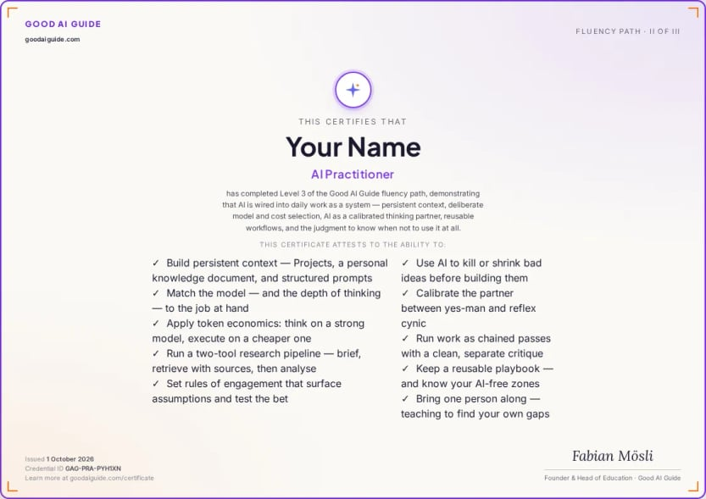
Work at Level 3 and you’re plausibly in the top 10–20% of AI users
WHERE IT LEADS
What Level 3 looks like
AI is part of how you work: persistent context, deliberate model choice, a real research pipeline and a thinking partner you’ve calibrated.
The AI Practitioner check
14 questions
11 to pass
Open book
PDF + LinkedIn
Open book and still not easy: the questions test judgment, so looking things up only gets you so far.
There’s no official ranking of AI skill, so this is my estimate. The reasoning and sources: goodaiguide.com/fluency-path
Notes:
Level 3 is where the effort pays off. It's called AI Practitioner: AI is part of how you work: persistent context, deliberate choice of model, a real research pipeline, and a thinking partner you've calibrated so it doesn't just agree with you. Work like that and you're plausibly in the top 10 to 20 percent of people who use AI. That's my estimate, not an official ranking, and the site explains exactly how I get there.
And yes, there's a certificate. It's open book and still not easy: the questions test judgment, so looking things up only gets you so far. Pass, and you get a PDF and a credential for your LinkedIn profile.

Slide 11











More than a book’s worth, in 10-minute pieces
THE LIBRARY
Five shelves
Start here
5
Strategy and leadership
7
Your AI Agrees With You Too Much
Giving Everyone Copilot Isn’t an AI Strategy
Don’t Let Your AI Grade Its Own Homework
Practitioner workflows
17
Building with AI
6
Perspectives
4
Every guide opens with its key takeaways: the point in 30 seconds, the method in 15 minutes.
Think Expensive, Execute Cheap
AI Makes You More of Whatever You Already Are
Let the AI Interview You
Notes:
Then there's the library: 39 guides, about 86,000 words, which is more than a book, cut into pieces you can read over a coffee.
They're grouped the way I'd read them: start here, strategy and leadership, practitioner workflows, building with AI, and perspectives. Every guide opens with its key takeaways, so you get the point in 30 seconds and the method in 15 minutes.
A few examples: why your AI agrees with you too much and what to do about it; why giving everyone Copilot isn't an AI strategy; and why you shouldn't let your AI grade its own homework. They come from real use at work, including what didn't work.

Slide 12









Honest ratings, with the reasons
TOOLS AND MODELS
24 models, sorted by the job
“I barely type anymore.”
Direct
Think
My take on Wispr Flow, voice dictation · 5/5
Execute
Search the live web
Run privately
Make images
“Microsoft botched this.”
Make video
Voice & music
My take on Copilot · 3/5
Which model is best? Depends on the job. For each one, the page names the model I’d pick.
42 tools, each with a rating and the reasons for it.
No sponsored rankings. If a link ever earns me money, it says so.
Notes:
Every week there's a new "best AI tool". The site rates 42 of them, and every rating comes with my reasons: from "I barely type anymore", which is my five-star review of a voice dictation tool, to "Microsoft botched this", which is about Copilot. Copilot's model is fine, by the way. The packaging isn't.
And for "which model should I use?", the models page sorts 24 models by the job you need done: directing, thinking, executing, searching the web, running privately, images, video and voice. For each job it names the one I'd pick.
Nobody pays for a placement. If a link ever earns me money, it'll say so right next to it.

Slide 13



Learn it by playing with it
PLAY
GAME
GAME · SIX SHORT ROUNDS
GALLERY
Out of Office
Gradient Descent
See What’s Possible
Three AI coworkers who forget everything overnight, and a train on Saturday. Get the hotel ready to run without you.
Roll a model downhill across the hills and valleys of its own errors, and feel how training works.
Working things AI built, each with the prompt behind it: a synthesizer, a 3D sailing scene, games, a film.
Everything runs in your browser. No account, nothing to install.
Notes:
Some ideas click faster when you can poke at them, so the site has games.
Out of Office is the newest one. You run your grandmother's mountain hotel, your train leaves on Saturday, and you've got three AI coworkers from an agency who are fast, confident and slightly wrong. And they forget everything overnight unless you write it down. It teaches delegating to AI better than a slide can, this one included.
Gradient Descent lets you feel how a model is trained, by rolling it downhill across its own errors. And See What's Possible is a gallery of things AI built from a prompt: a synthesizer, a 3D sailing scene, games, a film. Each one comes with the prompt, so you can try it yourself.

Slide 14






Yes, but…
OBJECTIONS
“I don’t have time.”
The quiz takes two minutes, and every guide puts the point in its first 30 seconds.
“My company blocked ChatGPT.”
Learn on your own tools with your own stuff. Bring the skills to work, never the data.
“Is it even safe?”
Fair question. One guide covers what happens to what you type, and what I do about it.
“I’m not technical.”
It’s written for people without a tech background. Every term is explained in plain language.
“I’ll wait until it settles down.”
I don’t think it’ll settle. And skill compounds, so waiting is the expensive option.
Notes:
Let's deal with the objections, because I hear them every time.
"I don't have time": the quiz takes two minutes, and every guide puts the point in its first thirty seconds.
"My company blocked ChatGPT": that's normal, and usually sensible. Learn on your own tools with your own material, like planning a trip or drafting a cover letter, and bring the skills to whatever your company gives you. Never the other way round: work data stays in work tools.
"Is it safe?": a fair question, and there's a guide on what actually happens to what you type.
"I'm not technical": I write for people with a real job, no technical background and no time.
And "I'll wait until it settles down": I don't think it will. And because skill compounds, waiting is the expensive option.

Slide 15






Five days, about 15 minutes a day
YOUR FIRST WEEK
MON
TUE
WED
THU
FRI
Find your level
Read one guide
Brief your AI
Tick three skills
Play
Take the two-minute quiz. There are no wrong answers.
The one the quiz suggests for your level.
Tell it who you are and how you like answers. Then ask last week’s question again.
Pick three from your level’s checklist and try them on real tasks.
A round of Out of Office, or a prompt from See What’s Possible.
2 min
15 min
15 min
15 min
15 min
Then repeat Tuesday to Thursday. There is no secret step six.
Notes:
So here's your homework, and it's small.
Monday: take the two-minute quiz. Tuesday: read the guide it suggests for your level, ten to fifteen minutes. Wednesday: brief your AI properly. Tell it who you are, what you do and how you like your answers, then ask it something you asked last week and compare. Thursday: pick three skills from your level's checklist and try them on real tasks, with the tools you're allowed to use at work, or privately with your own stuff. Friday: play. A round of Out of Office, or a prompt from See What's Possible.
Then repeat Tuesday to Thursday. That's the whole method. There is no secret step six.

Slide 16

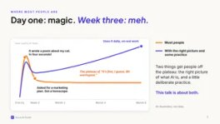
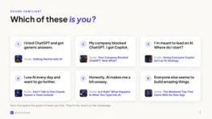
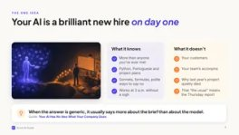

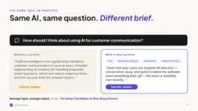
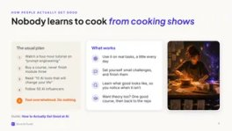
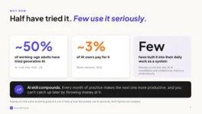
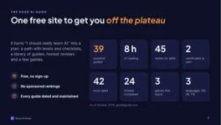
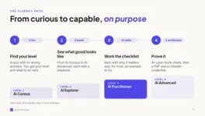
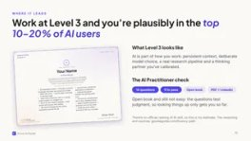

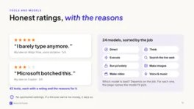
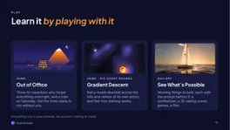
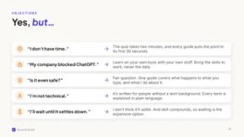
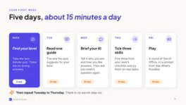
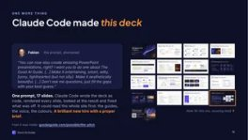

Claude Code made this deck
ONE MORE THING
Fabian · the prompt, shortened
“You can now also create amazing PowerPoint presentations, right? I want you to do one about The Good AI Guide. […] Make it entertaining, smart, witty, funny, lighthearted (but not silly). Make it aesthetically beautiful. […] Don’t ask me questions, just fill the gaps with your best guess.”
One prompt, 17 slides. Claude Code wrote the deck as code, rendered every slide, looked at the result and fixed what was off. It could read the whole site first: the guides, the voice, the colours. A brilliant new hire with a proper brief.
Slide 16: this one, showing itself ↑
How it was made: goodaiguide.com/possible/the-pitch
Notes:
One more thing.
Everything you've seen in the last twenty minutes, the storyline, the jokes, the charts, the layout and even these speaker notes, was made by Claude Code from one prompt I typed. [Pause.]
It wrote the deck as code, rendered every slide to a picture, looked at them, and fixed what was off.
It could do that well because it was working inside my website's project. It could read every guide, my writing rules, the colours and the fonts. A brilliant new hire with a very good brief. That's this whole talk in one slide.
The full prompt and the story of how it was made are on the site, under See What's Possible.

Slide 17



Find your level
in two minutes
YOUR MOVE
goodaiguide.com/quiz
Free. No sign-up. Your answers stay in your browser.
Newsletter: goodaiguide.com/newsletter
Say hi: Fabian Mösli on LinkedIn
Notes:
That's it from me.
If you do one thing today, scan this code and take the quiz. It takes two minutes, there are no wrong answers, and it tells you exactly where to start.
If you'd like to hear when I've learned something worth sharing, there's a newsletter, roughly once a month. And if you'd like to talk about any of this, find me on LinkedIn. I'm always up for a virtual coffee.
[Questions?]

